Slide 1
Dragon SMC Network
Jim Hansen
2/25/2020

Slide 2
Agenda
Network Layout
IP Assignment
Tester PCs
SMC Devices
System Node Ethernet Operations
Discovery
Polling
DHCP Server Operations
Installation / Startup
Server Log

Slide 3
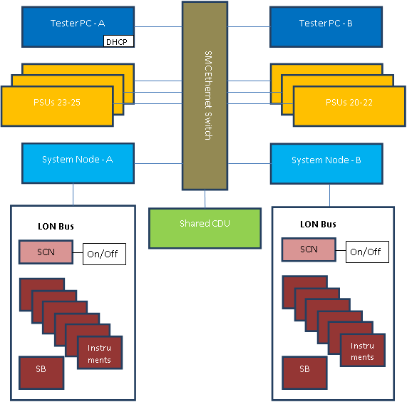
SMC Network Diagram
SMC Network is shared by all testheads in system
DHCP Server for testhead instruments
Tester PC of Head A runs the DHCP Server for SMC Network
[must be running to provide SMC devices with IP addresses]
LON Bus is independent per test head

Slide 4
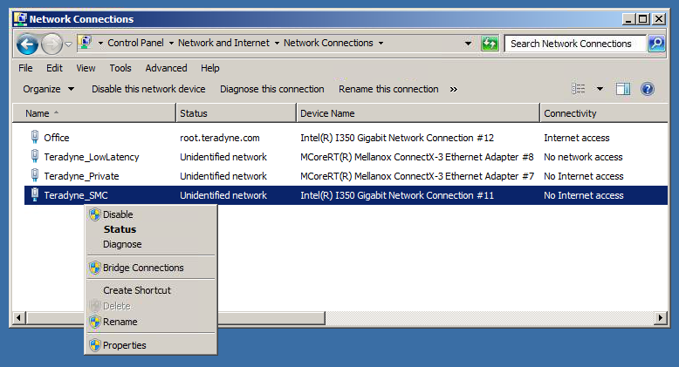
IP Assignment – Tester PCs
The Teradyne_SMC network uses static IP addresses for all tester PCs
The assigned address defines the subnet for SMC devices
All PCs in a multihead system must be assigned to same subnet
Right-Click on Teradyne_SMC connection to Rename or set static IP address in Properties

Slide 5
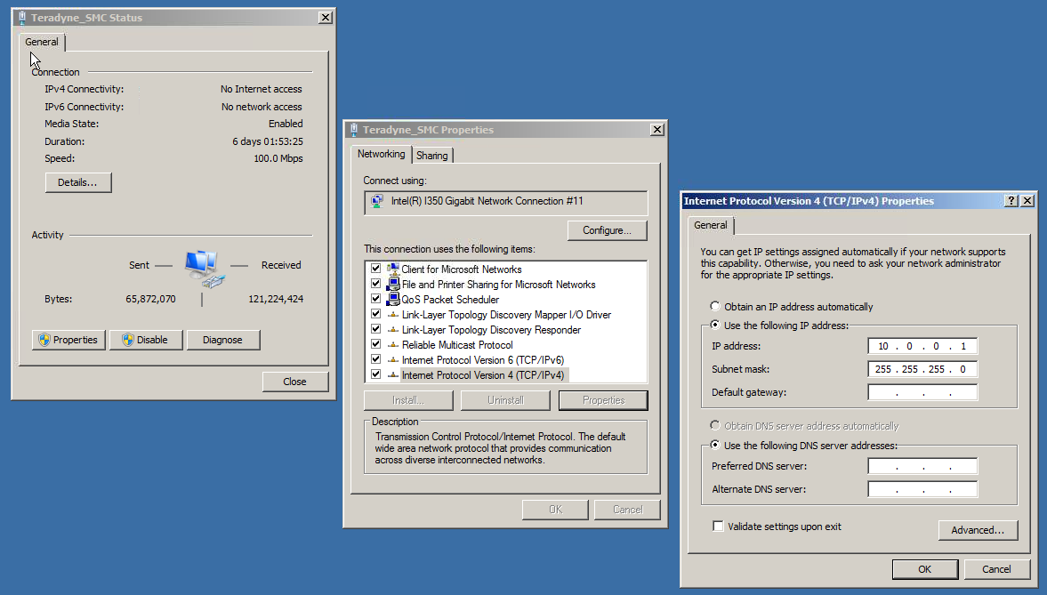
IP Assignment – Tester PCs (cont.)
IP address sets SMC subnet
Head A: IP ends in .1
Head B: IP ends in .3
Subnet mask always 255.255.255.0

Slide 6
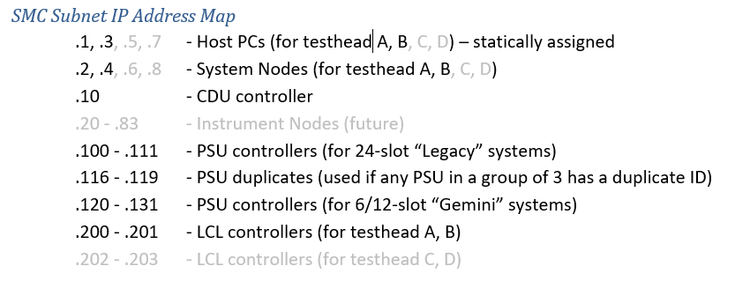
IP Assignment – SMC Devices
Device IP addresses assigned by DHCP server running on Tester PC of Head A
Final octet assigned to devices as shown in table

Slide 7
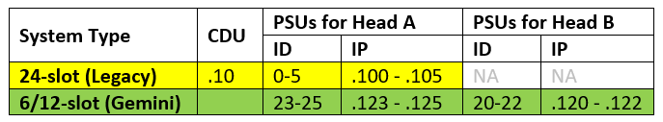
System Node Ethernet Operations
IP address is assigned by DHCP server running on Tester PC of Head A
SN reboots until an IP address is assigned
CDU and PSUs are “discovered” during initialization based upon IP addresses
SN attempts to discover PSUs by IP address based upon system type and head
SN also attempts to discover PSUs at IP addresses reserved for “duplicates” (.116-.119)
SN polls CDU and PSUs every second to maintain communication links

Slide 8
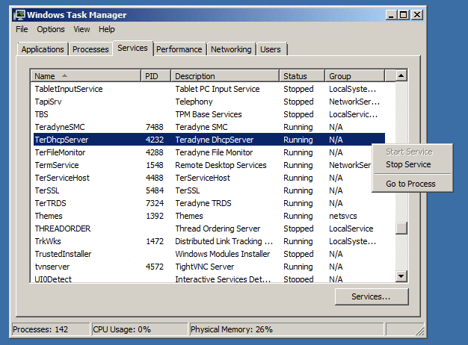
DHCP Server Operations – Install / Startup
The Teradyne DHCP (/TFTP/RDATE) Server is installed on all Tester PCs
IG-XL Installer installs/updates DHCP server during kit installation
DHCP Server (TerDhcpServer.exe) is located in C:\Program Files (x86)\Teradyne\IG-XL\Common\bin\
IG-XL configures DHCP Server to run at Windows startup
DHCP Server status may be checked or changed through Windows Task Manager > Services
DHCP Server for SMC network only runs on Tester PC of Head A

Slide 9
DHCP Server Operations – Logging
DHCP Server logs all operations to C:\Temp\TerDhcpServer.log
Server starts (from tester PC power cycles)
Server restarts (from network cable changes, NIC name changes, etc.)
Network connections detected
Teradyne_Private
Teradyne_SMC
Existing IP assignments detected upon (re)start
SMC Devices
New IP assignment requests received
Includes MAC address, host name
New IP assignments provided
Includes device type identified, IP address assigned
Errors detected
See DragonSMC-Network.docx for examples of TerDhcpServer.log examples

